Slide 1


HANGMAN GAME
Priyonti Tabassum Haque Dizzya-Al-Fahad
2511777042 2512656642
priyonti.haque.251@northsouth.edu dizzya.fahad.251@northsouth.edu
Sumaiya Yasmin Nairit Avishek Saha
2513948642 2411416624
sumaiya.nairit.251@northsouth.edu avishek.saha.241@northsouth.edu

Slide 2
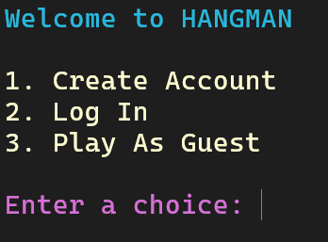




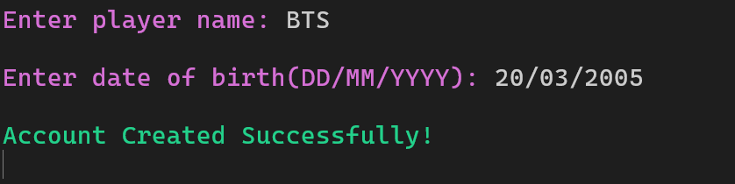
OVERVIEW
Developed in C with interactive features.
CORE FUNCTIONALITY
Login system
Progress tracking
Multiple game modes
Achievement unlocking

Slide 3
KEY FEATURES
4 Modes:
Normal Time Challenge
Multiplayer Time Attack
Dynamic scoring (-1 for wrong guesses, -3 for hint, +5 for correct letters)
Hints (3 max) and level-based difficulty

Slide 4
PLAYER STATS AND REWARDS
Tracks streaks, high scores, badges (e.g. "Mind Master")
Titles for level-ups, badges for achievements

Slide 5
GAMEPLAY MECHANICS
6 incorrect guesses max → stick figure hanged.
Hints after 3 wrong guesses (-3 points per hint).
First letter revealed in harder levels.
if (tries == 3 && !gameOver && !hintTaken) {
offerHint();
}
if (player.level >= 3) {
revealLetter = true;
}

Slide 6

MULTIPLAYER MODE
Alternates between Player 1 (logged in) and Player 2
Tracks scores across rounds and declares a winner

Slide 7


Slide 8


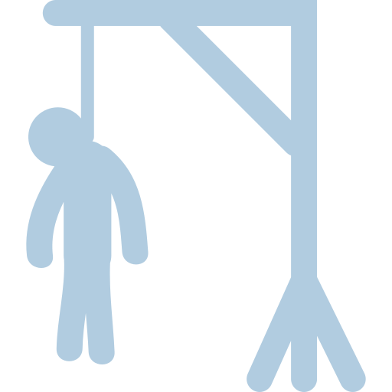

Slide 9
FILE *file = fopen("players.txt","r");
FILE *tempFile = fopen("temp.txt","w");
while (fscanf(file, "%s %d", tempName,
&age) != EOF) {
if (strcmp(tempName, player.name) == 0) {
fprintf(tempFile, "%s %d\n",
newPlayerName, age);
} else {
fprintf(tempFile, "%s %d\n", tempName, age);
}
}
fclose(file);
fclose(tempFile);
remove("players.txt");
rename("temp.txt", "players.txt");
CHALLENGES
User Input Validation
Streak Tracking Across Sessions
Game Logic Complexity
Real-Time Updates

Slide 10
FUTURE IMPROVEMENTS
XP Achievement System
In-game Points and Bonuses
More Customisation Controls
Enhanced Visuals (e.g., Themed Backgrounds)
UX Implementation

